Slide 1
What Makes A Church Worth Boasting Of?
Part 2
2 Thessalonians 1:1-5
All Scripture quotations are from the NKJV unless noted.

Slide 2
Previously
Adopted and Redeemed (1:1, 2)
Growing Faith (1:3)
Abounding Love (1:3)

Slide 3
4. Patient Hope
⁴ “so that we ourselves boast of you among the churches of God for your patience and faith in all your persecutions and tribulations that you endure”
Paul remembered their “patience of hope” (1 Thess. 1:3)
Was concerned that Satan had spoiled their faith (1 Thess. 3:1-5)
They continue to endure

Slide 4
Luke 21
16 "You will be betrayed even by parents and brothers, relatives and friends; and they will put some of you to death.
17 "And you will be hated by all for My name’s sake.
18 "But not a hair of your head shall be lost.
19 "By your patience possess your souls.

Slide 5
Fragile Faith?
An egg is fragile
Glass is fragile
Life is fragile
Does Faith Need BUBBLE WRAPPED?

Slide 6
Fragile Faith?
20 "But he who received the seed on stony places, this is he who hears the word and immediately receives it with joy;
21 "yet he has no root in himself, but endures only for a while. For when tribulation or persecution arises because of the word, immediately he stumbles.
Mathew 13:20, 21

Slide 7
Genuine Faith Is Not Fragile
FRAGILE FAITH
Consumed by fire
Flees persecution
Does not seek to fully obey the word
Finds itself needing to forgive God
GENUINE FAITH
Does not perish
Does not run away
Seeks to obey all of God’s word
Remembers the pardon from God
“A man is not established by wickedness, But the root of the righteous cannot be moved” (Prov. 12:3)

Slide 8
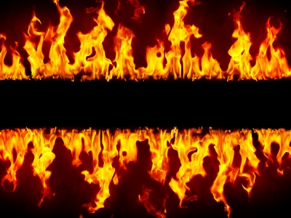
FAITH
Tested By Fire

Slide 9
FAITH
“Beloved, do not think it strange concerning the fiery trial which is to try you, as though some strange thing happened to you; but rejoice to the extent that you partake of Christ’s sufferings, that when His glory is revealed, you may also be glad with exceeding joy” (1 Pet. 4:12, 13)
HOPE

Slide 10
FAITH
Recognize hard times will come
Read the examples in scripture
Regard the mind and example of Jesus
Remember a day of recompense is coming
HOPE

Slide 11
5. Kingdom Mindset
⁵ “which is manifest evidence of the righteous judgment of God, that you may be counted worthy of the kingdom of God, for which you also suffer”
Their endurance in the face of persecution is evidence for a future judgment of righteousness
What are we are willing to endure for the kingdom?

Slide 12
Matthew 6:33
“But seek first the kingdom of God and His righteousness, and all these things shall be added to you.”

